Slide 1

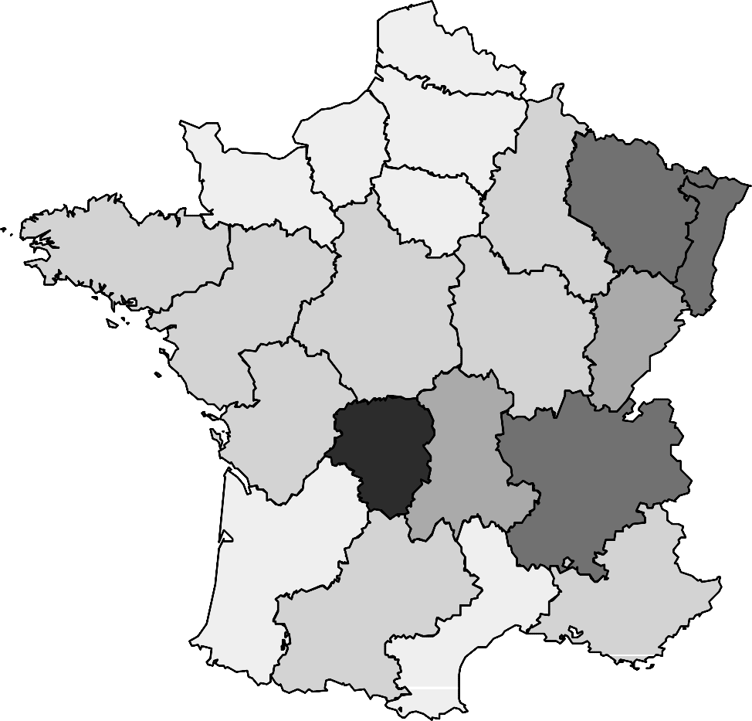
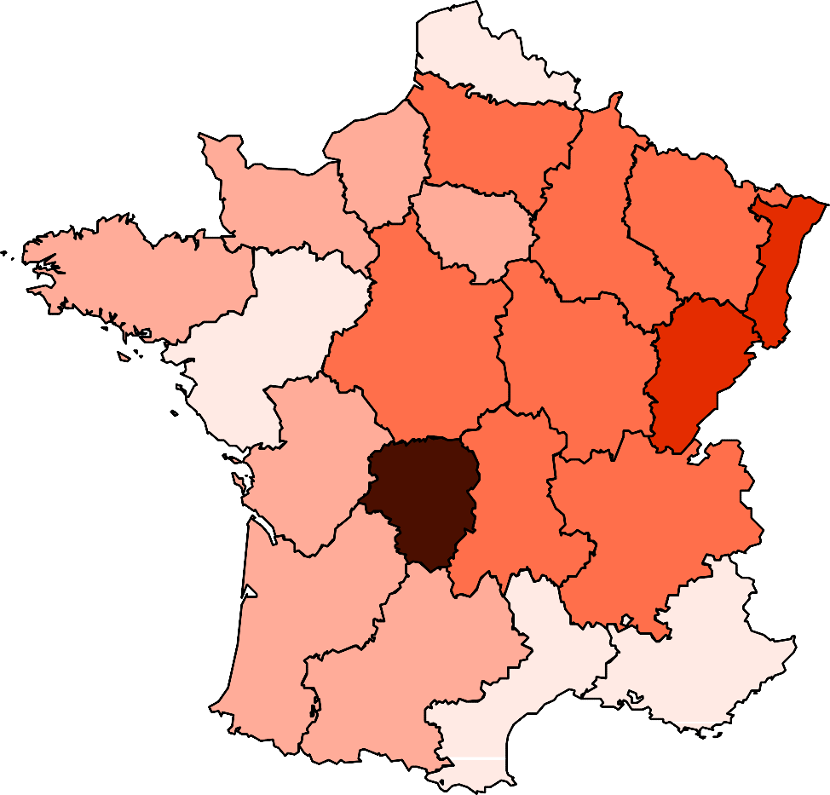
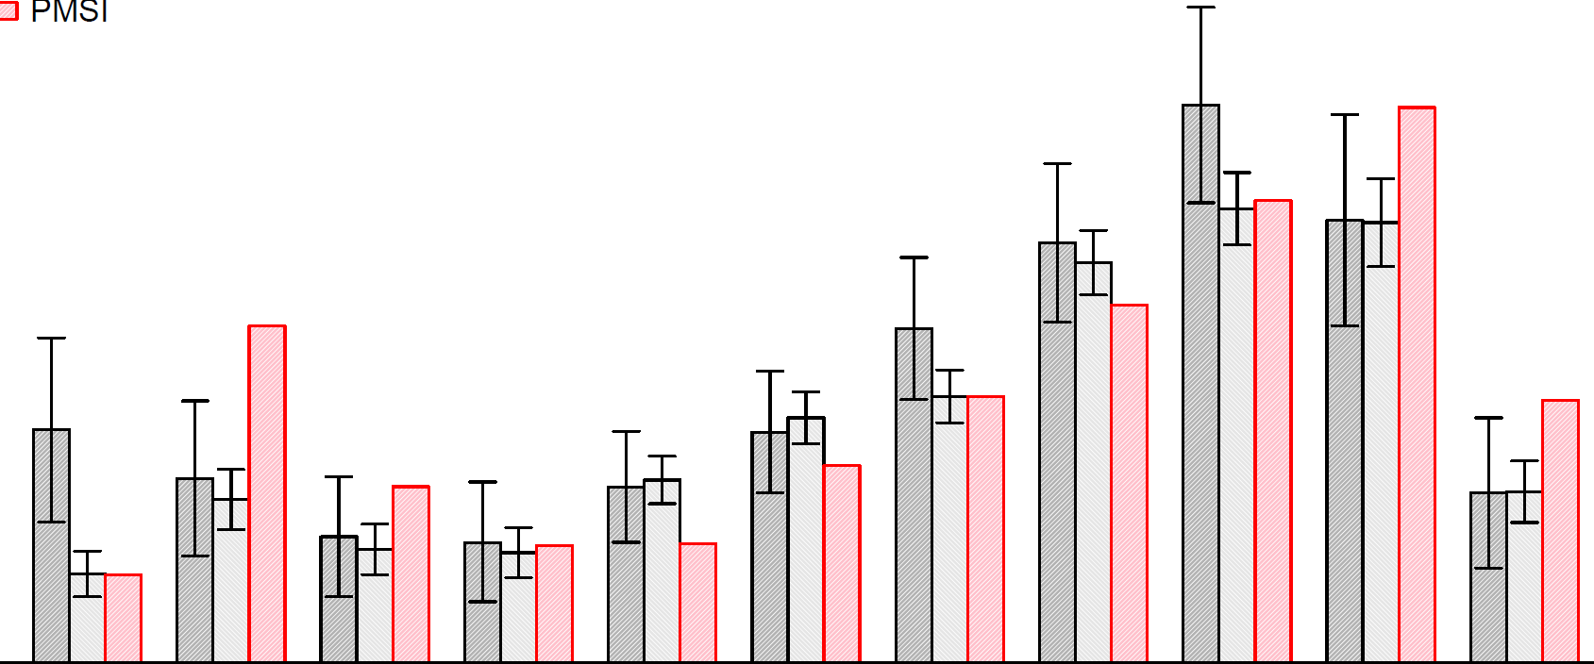


Epidemiology of Lyme borreliosis in France in primary care and hospital settings, 2010 to 2019
P048
Charles Nuttens¹, Stéphanie Duret², Antoine Bessou², Jozica Skufca³, Emmanuelle Blanc¹, Andreas Pilz⁴, Bradford D. Gessner⁵, Jean-François Faucher⁶, James Stark⁵
1. Pfizer, Paris, France ; 2. IQVIA, Courbevoie, France ; 3. P95, Leuven, Belgium ; 4. Pfizer, Vienna, Austria ; 5. Pfizer, Collegeville, USA ; 6. CHU de Limoges, Limoges, France
Introduction
Methods
In France, Lyme borreliosis (LB) incidence is mainly derived from the national Sentinel network and the national hospital discharge database (PMSI) to describe the epidemiology in primary care and hospital settings respectively. Data up to 2016 were analysed and published.
Our study compared incidence rates of LB by sex, age and region in primary care and hospital settings between 2010 and 2019, using for the first time an additional source of data in primary care.
Incidence rates of LB in primary care were estimated between 2010 and 2019 using data from the Sentinel network and electronic medical records (EMR) of a network of general practitioners independent of the Sentinel network.
Hospitalization rates were calculated between 2012 and 2019 from the national hospital discharge database (i.e. Programme de Médicalisation des Systèmes d’Information - PMSI). Hospitalized cases were identified using an algorithm combining 3 LB specific ICD10 codes (A69.2, M01.2 and L90.4) and compatible codes for disseminated forms.
Average annual incidence rates were calculated for 2010-2012 and 2017-2019 to smooth annual variability.
Results
Evolution of incidence rate (2010-2019)
Average sex ratio by age group (2010-2019)
Incidence rates in primary care increased from 42 cases/100,000 population from 2010-2012 to 83/100,000 in 2017-2019 for the Sentinel network and from 43/100,000 to 75/100,000 for the EMR.
The hospitalization rate remained stable during the study period, fluctuating between 1.6 and 1.80 admission/100,000 population.
Women were slightly predominant in primary care (1.1 women/1 man).
Men were predominant among hospitalizations (1.4 man/1 woman), mainly in adolescents aged 10-14 years (1.9 boys/1 girl) and in adults with a maximum in 80 years of age and older (2.6 men/1 woman).
incidence rate in primary care
(cases for 100,000 population)
120
Sentinel network Electronic Medical Records PMSI
hospitalization rate
(hospitalization for 100,000 population)
sex ratio (man/woman)
3.0
Electronic Medical Records PMSI
100
4
2.5
More men
80
3
2.0
60
2
1.5
40
1
1.0
More women
20
0.5
0
2010
2011
2012
2013
2014
2015
2016
2017
2018
2019
0
0.0
0−4
5−9
10−14
15−19
20−29
30−39
40−49
50−59
60−69
70−79
80+
age group
Average incidence rate by age group (2017-2019)
Average incidence rate by region (2017-2019)
From 2017-2019, the age distribution was bimodal with the first peak in children aged 0-4 years for the Sentinel network (65/100,000) and 5-9 years for the EMR (46/100,000) and a second peak in individuals 60-69 years of age (Sentinel network:156/100,000 ; EMR:127/100,000).
The age distribution of hospitalization was also bimodal with a peak in children aged 5-9 years (2.0/100,000) and adults aged 70-79 years (3.4/100,000).
The regional incidence rate in primary care was highest in Limousin (Sentinel network: 330/100,000 ; EMR: 356/100,000) and Alsace (Sentinel network: 244/100,000 ; EMR:162/100,000).
Similarly, incidence rates in the hospital setting were the highest in Limousin (8.2/100,000) and Alsace (3.4/100,000).
incidence rate in primary care
(cases for 100,000 population)
200
Sentinel network Electronic Medical Records PMSI
4
hospitalization rate
(hospitalization for 100,000 population)
150
3
incidence
incidence
100
2
0 – 50
50 – 100
100 – 150
150 – 200
200 – 250
250 – 300
300 – Inf
0 – 1
1 – 2
2 – 3
3 – 4
4 – 5
5 – 6
6 – Inf
50
1
Sentinel network
PMSI
0
0−4
5−9
10−14
15−19
20−29
30−39
40−49
50−59
60−69
70−79
80+
age group
Conclusion
Incidence rates of LB were high in specific age groups and regions which may inform public health prevention initiatives.
Comparing for the first time 3 independent data sources highlighted disparities in incidence evolution, sex ratios and predominant age groups between cases seen in primary care and hospital settings.
References
1. Septfons A et al, Euro Surveill. 2019;24(11):pii=1800134
2. Réseau Sentinelles, INSERM/Sorbonne Université, sentiweb.fr
Charles Nuttens, PhD
Medical Development, Scientific and Clinical Affairs - Pfizer
23-25 avenue du Docteur Lannelongue, 75014 Paris, France
charles.nuttens@pfizer.com - 0000-0001-6288-8023
Scan the QR code
to download the PDF version of the poster

